Slide 1
Mathematical Modelling
Lesson 4
Coffee and a cruise
Level 10

Slide 2
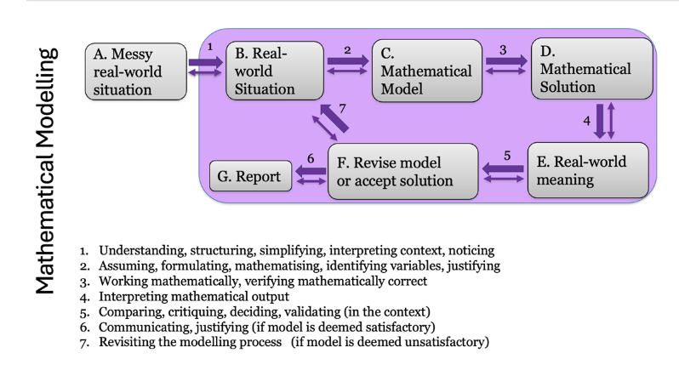
Mathematical Modelling Cycle

Slide 3
Coffee and a Cruise: Focus on Communication
In this lesson you are given two real-world problems to solve. As you solve these (individually or in pairs), focus on clearly communicating your solution to the real-world problem. Do this as you go through the process rather than once you think you have a solution. Think about the real-world situation at all times, not just the beginning and end.
Use these questions to help your communication:
Have you specified – in your words what the real-world problem is?
Are you making any assumptions? Are these clearly communicated?
Have you formulated a mathematical problem to be solved?
Are the methods you used clearly communicated?
At stages where you made a choice (e.g., to use a spreadsheet, to select a linear model), have you explained why these are sensible decisions?
As you solve the problem by applying your mathematical model(s), are your mathematical outputs clear? Are interim results checked? Are they reasonable?
Are your mathematical results clearly interpreted in terms of the real-world context?
Do your models need revising or modifying? (This may occur during your solving, or it might be something to discuss as you reflect on your solution as a consideration for the future.)
Is your solution reasonable?
Think about the audience reading your solution. If a student is away today, or another maths teacher reads your solution, will they understand all your thinking and mathematical work?
Not all question are equally relevant to the two problems. The list contains general guidance to consider when solving mathematical modelling tasks and communicate this.

Slide 4
The River Cruise Task
Chris’s family company offers a three-hour river cruise. The boat goes 15 km upstream and then returns to the jetty where the shop is docked. The river has a current of that on average flows a 2 km an hour.
Part 1A: Make a sketch of the situation to represent your understanding of the information (this is known as a situation model). Make a second simplified sketch that only includes information relevant to your intended approach to solve the problem. Record what information has been excluded or simplified and why.
Part 1B: What is the average boat speed and how long is the upstream part of the journey? Communicate the results of Part 1 of the problem before proceeding to Part 2.
Part 2: Recently Chris has noticed that some tourists consider the trip takes too long and hence do not take a cruise. Chris contemplates offering one or more shorter trips. Consider 2 options for Chris, detailing the time of the trips, and the distance to be travelled.

Slide 5
The Coffee Task
Location | Altitude above sea level (metres) | Boiling Point (°C)
Bowral | 681 | 97.8
Bungendore | 695 | 97.6
Dorrigo | 755 | 97.6
Jindabyne | 918 | 96.8
Katoomba | 1025 | 96.5
Lithgow | 916 | 96.8
Mount Victoria | 1071 | 96.3
Oberon | 1103 | 96.3
Orange | 869 | 97.1
Perisher Village | 1721 | 94.2
Taralga | 842 | 97.3
Thredbo Village | 1447 | 95.2
Wallerawang | 898 | 97.1
Did you know that water temperature plays a key role in Barista Quality Coffee.
Water temperature impacts the amount and taste of coffee.
Baristas can adjust the temperature of the machine they are using. The water temperature is just one of several variable that impact the final product when making coffee.
However, before adjusting the temperature it is important the coffee machine is set up correctly according to altitude.
Use the data provide here to develop a rule-of-thumb that baristas can use to calibrate their coffee machines. Note in problems such as this, it is wise to withhold one row of the data and use that to test your model.

